Slide 1
INFORMATION & COMPUTING

Slide 2
Overview
Examine how data communication
Examine the conversion bewteen digital and analog signal
Examine how electronic devices can do computing

Slide 3
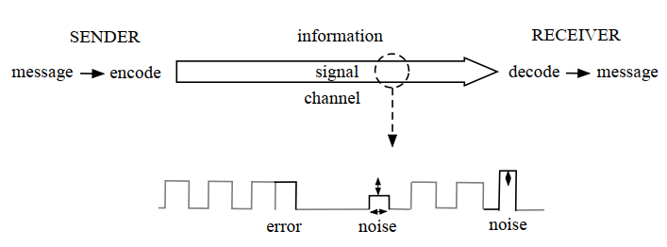
INFORMATION CONTENT
The sender/receiver model provides an universal description of communication
Shanon’s model of information transfer

Slide 4
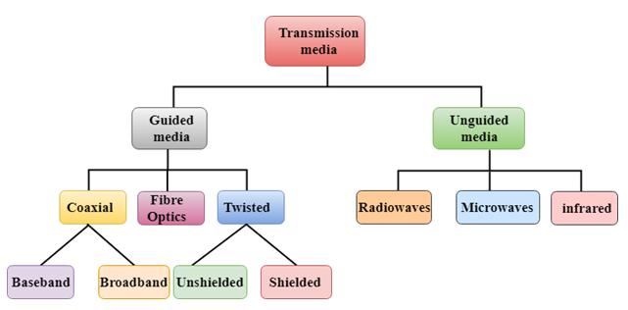
Signal transmission

Slide 5
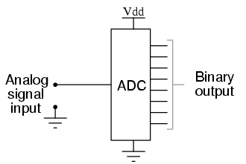
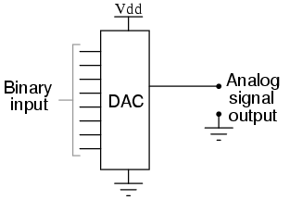
A/D AND D/A CONVERSION
ADC (Analog to Digital Conversion)
A continuous physical signal needs to be periodically sampled to form a sequence of values that represent the amplitude of that signal
It is called discretize
DAC (Digital to Analog Conversion)
The inverse of ADC is performed by a DAC, which interprets a digital code and generates a corresponding (semi-)continuous signal.

Slide 6
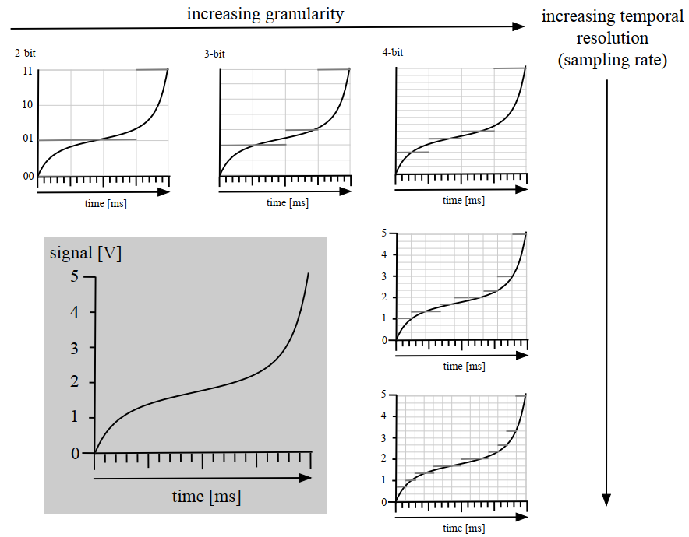
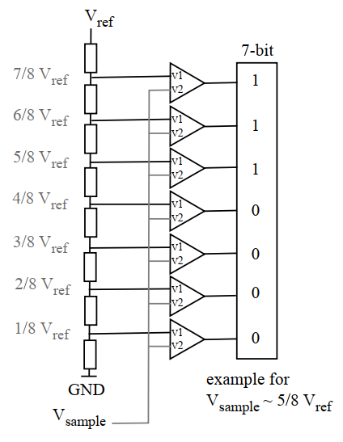
ADC

Slide 7
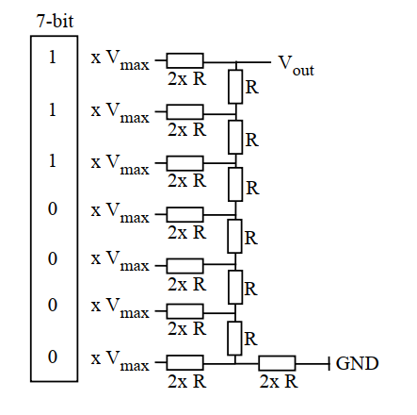
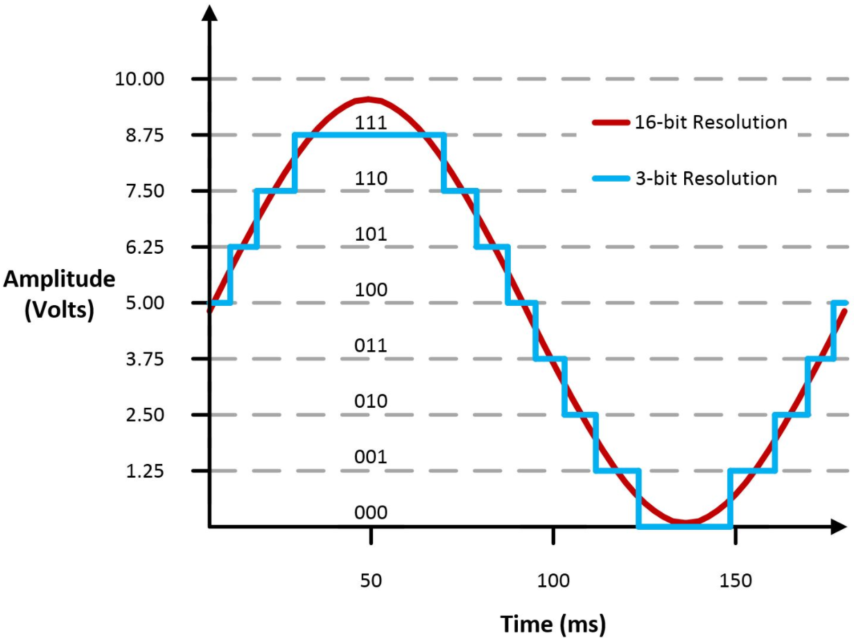
DAC

Slide 8
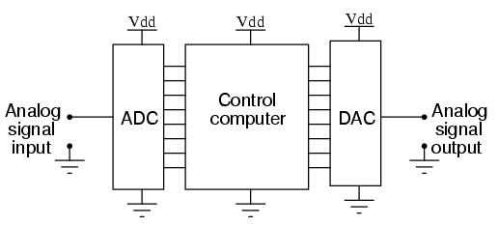
Digital signal processing
Digital signal processing in the shorten is DSP
analogous input → ADC → DSP → DAC → analogous output

Slide 9
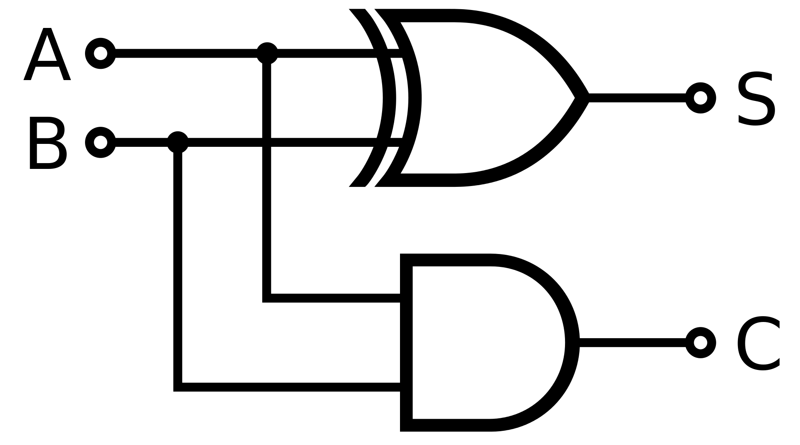
Computing
Any logical and mathmetic operator can be done by logic gates
Examples: Half adder
Inputs |  | Outputs
A | B | C | S
0 | 0 | 0 | 0
0 | 1 | 0 | 1
1 | 0 | 0 | 1
1 | 1 | 1 | 0

Slide 10
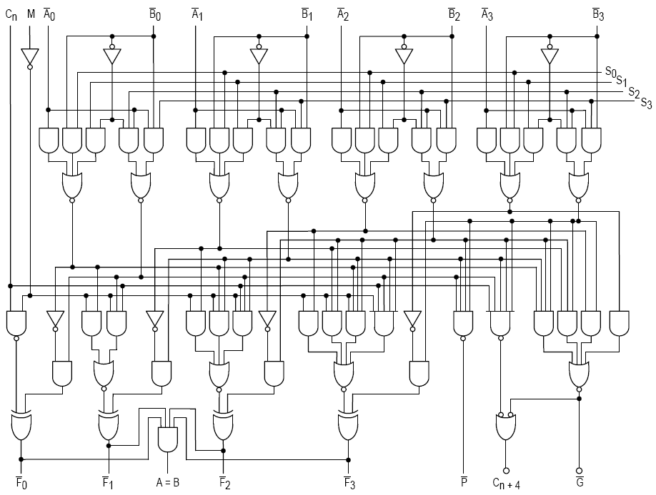
Computing
ALU (arithmetic logic unit) is a combinational digital gates that performs arithmetic and bitwise operations on integer binary numbers
Example: 4bits ALU
Notes:
S: Summary
C: Carry

